Slide 1
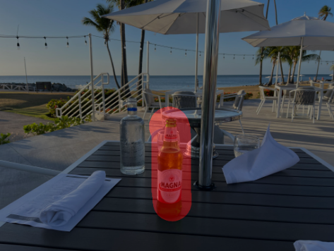
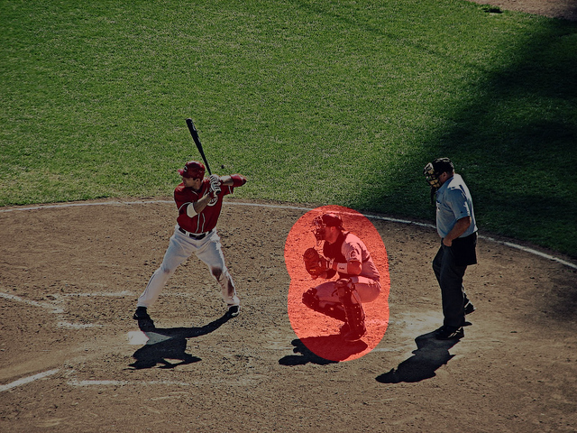
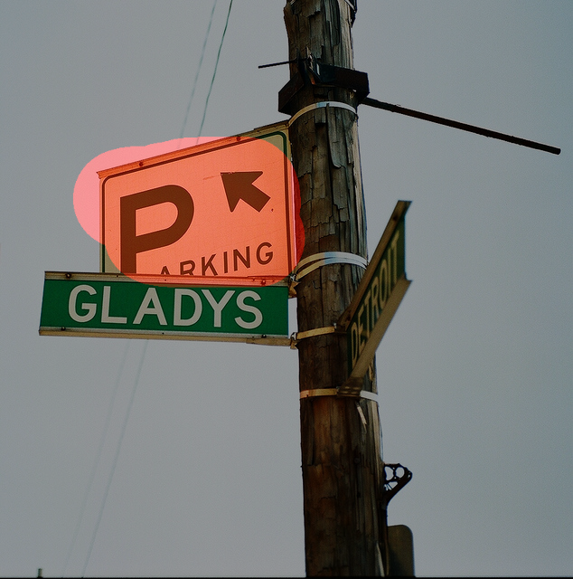


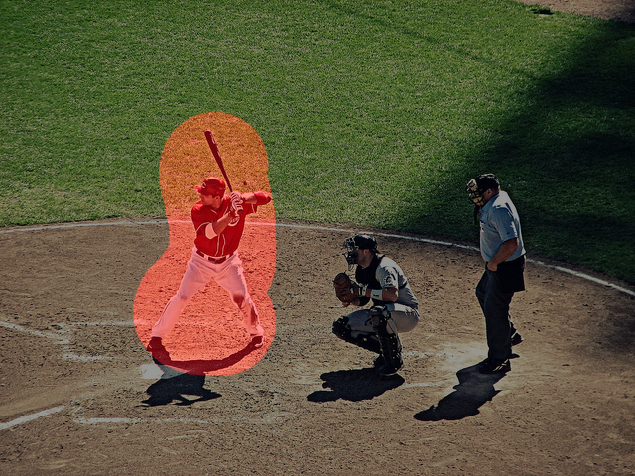
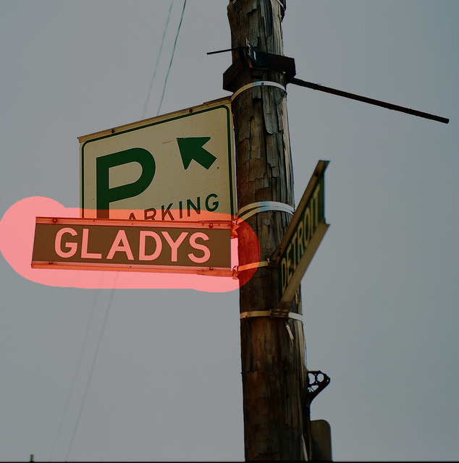
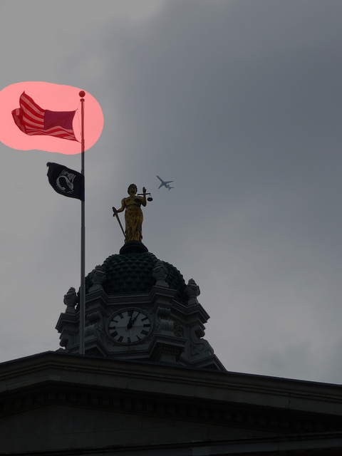
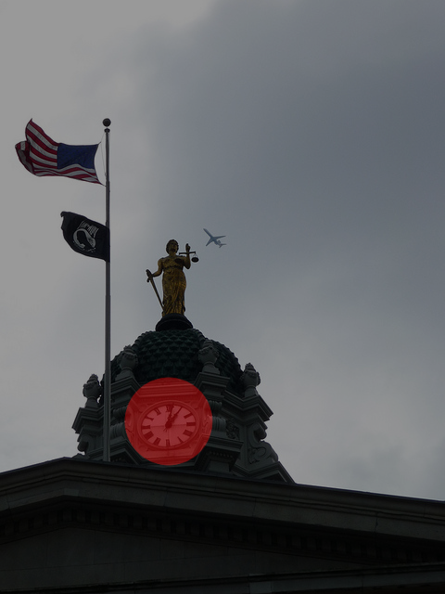
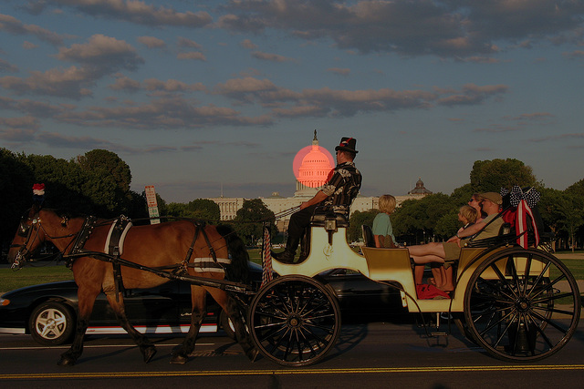
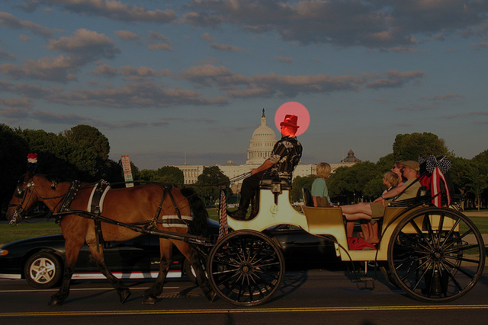
What is this man doing in the image?
What's the meaning of this sign?
What is in the bottle?
The man is playing baseball, specifically as a catcher, and is in the process of catching a ball during a game.
This sign indicates that there is a parking area nearby, possibly a designated parking zone.
The bottle contains beer.
But l want to drink water
now, what should I do?
There are two water bottles on the table, so you can choose one of them to drink water.
Where are them exactly?
What is this man doing in the image?
What's the meaning of this sign?
The two water bottles are located on the table, next to the beer bottle.
The man is standing at home plate, holding a baseball bat, and preparing to swing at an incoming pitch during a baseball game.
The sign in the image is a street sign that reads "Gladys." This sign indicates the name of the street where the pole is located.
The image features a statue of a woman holding scales, which is situated on top of a building. The statue is positioned in front of a large American flag, which is flying high on a pole. In the background, there is an airplane flying overhead, adding a sense of motion and activity to the scene. The combination of the statue, the flag, and the airplane creates a dynamic and visually interesting composition.
The image features a large clock mounted on the side of a building, with a statue of a woman holding scales nearby. The clock is prominently displayed, and it appears to be a central feature of the building. In the background, there is an airplane flying, adding a sense of motion and activity to the scene. The combination of the clock, statue, and airplane creates an interesting and dynamic visual composition.
The image depicts a group of people riding in a horse-drawn carriage on a street in front of the U.S. Capitol building. The carriage is being pulled by two horses, and there are several people visible in the scene, including a man riding the carriage and others standing nearby.
The image features a horse-drawn carriage with a man wearing a top hat driving the carriage. There are several people in the scene, including a man sitting on the carriage, a woman sitting on the back of the carriage, and other individuals standing nearby. The carriage is moving down a street, and the people appear to be enjoying the ride.

